Slide 1


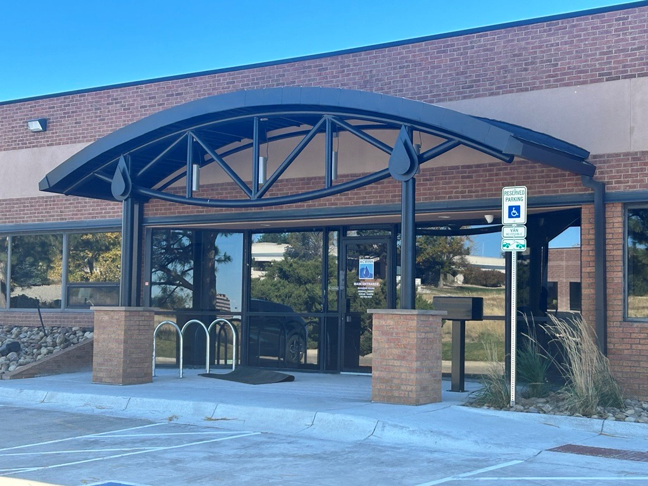
Commercial Business Welcome Packet
Account #
Mission of Arapahoe County Water and Wastewater Authority:
To provide sustainable water/wastewater services by optimizing our resources to ensure quality and value while protecting the environment.
♦7135 S. Tucson Way, CO 80112Phone: (303) 790-4830Fax: (213) 947-1841
www.acwwa.com

Slide 2



Welcome!
We are pleased to have you as a customer in our service area
Arapahoe County Water and Wastewater Authority (ACWWA, pronounced Aqua) provides the drinking water and wastewater services to the people living and working within its service area.
ACWWA serves an area of more than eight square miles in the southeastern Denver metropolitan area, approximately ten miles from downtown Denver. Our service area is comprised of about 4,000 residences and businesses located primarily in Arapahoe County and northern Douglas County.
Please take a moment to visit our website at www.acwwa.com. It will point you to important information and resources about our services.
Our Vision… To be a leading water/wastewater utility by providing exceptional service for our current customers and future generations.
Who do I contact if I have a concern or question?
Our purpose is to provide you with quality service and excellent customer care. Should misunderstandings or mistakes occur, we welcome the opportunity to review the matter so problems can be corrected or clarified. We welcome suggestions concerning how we may improve our service to you. If you have questions, please feel free to contact us at 303-790-4830, or you may email us at contactus@acwwa.com.
Office Hours/Location
We are located at 7135 S. Tucson Way, Centennial, CO 80112. Our office hours are Monday–Friday, 8:00 am to 4:30 pm. We are closed on most legal holidays.
Phone Numbers
Our office phone number is 303-790-4830. Call this number for questions regarding your bill, changes to your account, and transferring or closing your account. Phone hours are 8:00 am to 4:30 pm.
Executive Team …………………… 303-790-4830
Back Flow………………………….. 303-790-4830
Billing……………………………… 303-790-4830
Customer Service………………….. 303-790-4830
Development……………………….. 303-790-4830
Locates………………………………811
Regulation 84 (Non-pot irrigation) ... 303-790-4830
♦7135 S. Tucson Way, Centennial, CO 80112Phone: (303) 790-4830Fax: (213) 947-1841
www.acwwa.com

Slide 3
Correspondence
Please direct all correspondence to:
Arapahoe County Water and Wastewater Authority
7135 S. Tucson Way, Centennial, CO 80112
What will my water and/or sewer service cost per month be?
Most customers want to know how much a water and/or sewer bill is likely to be per month. High water promotes efficient water use. We have adopted Conservation Block Rates. This means that the more water you use, the higher the billing rate. You may view current rates on our website at: http://acwwa.com/DocumentCenter/Home/View/155. Residential and commercial water and sewer rates can be found in section 2 of Appendix A.
Billing Statements
Your bills are mailed monthly and are issued approximately the first week of each month, although dates do vary slightly since we do not bill on weekends or holidays. If at any time you do not receive your bill, you can call us at 303-790-4830 and request a duplicate or you can go online to view/print a copy of your bill.
How do I pay my bill?
We have several different payment methods. Pick the one that suits you. Please do not send cash in the mail.
By Mail
Payment should be mailed in the envelope provided with the bill. The payment envelope has the mailing address pre-printed to go directly to our payment post office box. Please allow five days when paying by mail. Our mailing address for payment is ACWWA, P.O. Box 201922, Dallas, TX 75320-1922.
In Person at our Office
Payments can also be made at our main office located at 7135 S Tucson Way, Centennial, CO 80112. There is also a 24-hour payment drop box at this location (located adjacent to the front door). Payments may be made by
  Cash - (must have the exact amount, we cannot make change)
  Personal check, Money Order, Cashier’s Check
  Credit Card (there is a 2.50% per $100 paid convenience fee)
Automatic Payment - Electronic Funds Transfer (EFT)
We offer this service after completion of an EFT–Debit Authorization form. Forms may be accessed on our website.
What if I have a high bill?
We understand that from time to time, a substantial increase in the volume of water may cause a higher water bill. If this occurs due to a water leak or other uncontrollable circumstance, please contact our Customer Service Department and ask them to explain ACWWA’s Uncontrollable Water Usage Policy. You may be eligible for a credit towards your bill.
7135 S. Tucson Way
Centennial, CO 80112Phone: (303) 790-4830Fax: (213) 947-1841
www.acwwa.com

Slide 4
Where does our water come from?
ACWWA utilizes several sources for drinking water – The ACWWA Flow Project, which currently accounts for about sixty percent (60%) of ACWWA’s water supply, along with shallow alluvial wells along Cherry Creek, and deep groundwater wells.
The ACWWA Flow Project is a water supply project that will serve the ACWWA service area and upon completion, will result in an annual average delivery of 4,400 acre-feet of renewable water to the ACWWA service area. This new water is being used to supplement current water supplies, providing a secure and high-quality water source for current and future ACWWA customers.
We have a question about our water quality. Who can we contact?
Here at ACWWA, we work around the clock to provide top-quality water to every tap. ACWWA utilizes groundwater for a portion of its drinking water supplies. Groundwater comes from shallow (alluvial) and deep aquifer wells. Certain characteristics that are common and are associated with groundwater sources can lead to issues with taste and hardness. Groundwater contains several naturally occurring minerals. These minerals affect the aesthetic (not a health concern) quality of water. These minerals can affect the color, odor, and clarity of the drinking water.
We are committed to ensuring that the quality of your drinking water meets government standards, and we are pleased to report that your water meets or exceeds all primary and secondary standards set for safety. The drinking water that ACWWA provides has been tested and continues to be routinely tested for compliance with all drinking water regulations.
Each year, we publish and mail to every customer an annual water quality report. You may contact our office at 303-790-4830 for the latest edition. If you have an immediate water quality problem, please contact us so that the problem can be investigated, (303) 790-4830, ext. 376.
For more information on water quality, visit our website at http://acwwa.com/2205/Water-Quality.
Water Efficiency
ACWWA has developed a water efficiency program to provide our customers with the tools they can use to reduce their water use. Reducing water use can translate into healthier landscapes, less impact on the environment, and, best of all, reduced water bills.
Because Colorado weather can vary drastically year to year, ACWWA staff continuously evaluate our system and potential water supplies. Water efficiency may be implemented in the spring and summer months. For more information, look for our tab Water Efficiency on ACWWA’s website. Information will also be included in your ACWWA utility bill.
What is Reuse or Reclaimed water?
Reclaimed water, sometimes called reuse water, comes from wastewater treatment plants where it has undergone treatment and purification. This water is reused for landscape irrigation. Extensive treatment and disinfection ensure that public health and the environment are protected. ACWWA’s reclaimed water meets or exceeds the Colorado Department of Public Health and Environment requirements. Due to capacity and distribution piping, this irrigation source is limited to a small portion of ACWWA’s customers.
♦7135 S. Tucson Way, Centennial, CO 80112Phone: (303) 790-4830Fax: (213) 947-1841
www.acwwa.com

Slide 5
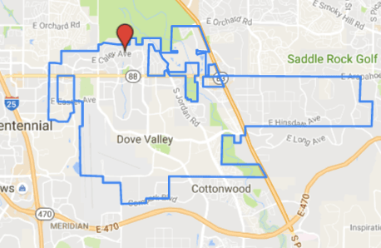
“Defending Water Quality and the Environment”
Contact Information
Monday - Friday, 8 am – 4:30 pm 7135 S. Tucson Way, Centennial, Colorado 80112 (303) 790-4830
(213) 947-1841 (Fax)
7135 S. Tucson Way
Centennial, CO 80112Phone: (303) 790-4830Fax: (303) 790-9364
www.acwwa.com

